Slide 1
What are the widely used data representation formats and their histories?

Slide 2
Week 04 assignments
Re-read chapter 3
HW 03 due Thursday, Feb 01
Lab 04 starts Jan. 30, due following week
Notes:
15 clickers recorded, but without associated student name

Slide 3
How to interpret homework feedback
HW 01 and HW02 scores are posted
GTAs insert comments into your upload file
Compare the posted Solution & Grading Guide with these comments to understand how your score was determined
Raise any issues promptly

Slide 4
Lecture 09 – Data representation
2018.01.29
“Everything around you is numbers.”
– Shakuntala Devi

Slide 5
Using binary strings to represent information
Binary strings will encode both program instructions and data
Designing representations, or formats, or encodings is done all the time
Creating a struct is designing a representation
Some representational schemes are encoded directly into the logic of computational circuits, such as adders
Encoding should not be arbitrary: design the encoding to satisfy goals and criteria

Slide 6
Hexadecimal notation, hex for short
Writing long bit strings is tedious and error prone
Hexadecimal notation (hex for short) encodes a group of 4 consecutive bits as one character from the base 16 digits 0,1,2,3,4,5,6,7,8,9,A,B,C,D,E,F
A bit string written in hex notation still has no meaning
A notation system confers no meaning
Hex is just a more compact and easy way to write bits
Example
DEC49 encodes the bit string 1101 1110 1100 0100 1001 D E C 4 9
Practice converting between hex and binary

Slide 7
Number representation schemes
There are stunningly many different ways to represent numbers
We will cover the most widely used weighted positional systems in computers
Number representation schemes are designed to have desirable characteristics
Want fast negation? You can have it
Want one circuit that both adds and subtracts? OK
Want to never have carry bits? Can do
What do you want from your number representation?

Slide 8
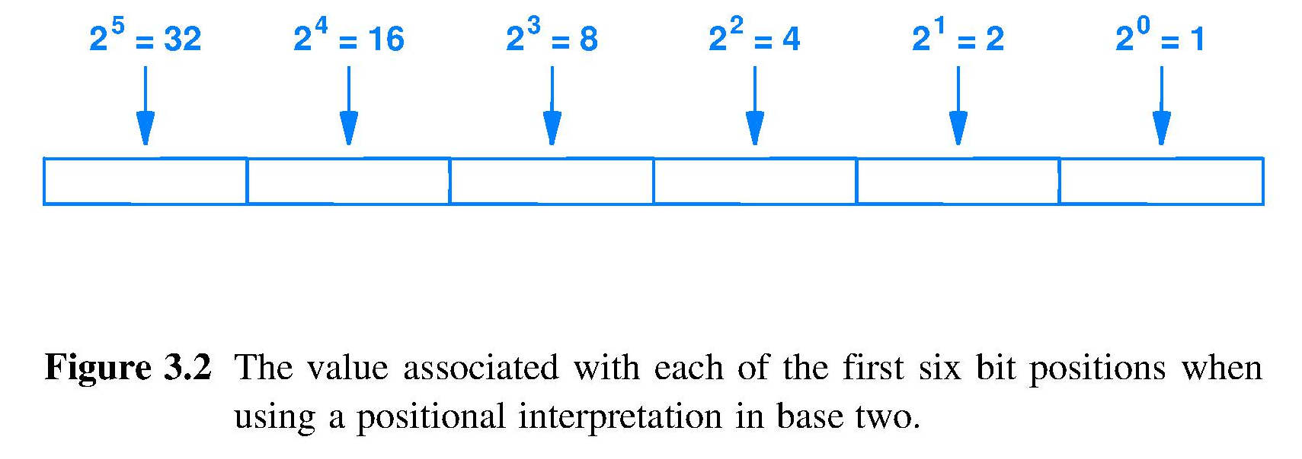
The binary weighted positional system
– Binary representation chosen to match binary logic circuits
– Weighted-positional system chosen so number of digits is ⌈ log₂ |number| ⌉ , ceiling of logarithm of number magnitude
Most significant bit (MSB)
Least significant bit (LSB)
0 0 1 0 1 1 is interpreted as 0x2⁵ + 0x2⁴ + 1x2³ + 0x2² + 1x2¹ + 1x2⁰= 11

Slide 9
Weighted positional forms for CS250
Our focus is these weighted positional forms
Unsigned: binary digits interpreted as binary digits; only can represent positive integers
Signed: one or more digits represent a + or – sign
Sign-magnitude: leftmost digit is an explicit sign
1’s complement (a.k.a. diminished radix complement)
2’s complement (also called radix complement)
BCD: encodes decimal digits to support decimal math
IEEE floating point: for scientific calculation

Slide 10
Unsigned integer
Straightforward use of binary weighted positional notation
No sign, so only non-negative integers
n bits can represent integers 0 through 2^{n}-1
Uses of unsigned integer representation
Encode the value of an address used by a decoder to point
Operands involved in pointer arithmetic
Essential for a processor to have unsigned add/subtract instructions

Slide 11
Sign magnitude integers
Leftmost bit represents sign: 0=+ and 1=–
Remaining bits represent magnitude of the integer using the weighted positional system
Quirk: has +zero and –zero representations
For 8-bit representation, quirk looks like 00000000 = +0 10000000 = -0 ^ sign bit

Slide 12
How does a designer choose a number representation?
Answer: Asks how well number system supports desired computations, i.e., How well does it meet my design criteria?
Example: What mathematical operations does sign magnitude make quick & cheap?
Negation [ invert sign bit, magnitude unchanged: uses 1 NOT gate]
|X| [ reset sign bit of number to 0 to get absolute value]
Convert to representation using larger number of bits, e.g. 32 to 64 [ insert needed number of zeros between magnitude and sign]
What mathematical operations are not quick & cheap for sign magnitude?
Comparison of two numbers for <, >, = Because there are two zeros, hardware must handle the special cases of -0 = +0 so a negative number is not simply less than a positive number; truth table requires a more complex circuit
Addition and Subtraction [add/sub computation is not enough: operand magnitudes must be compared to compute sign of result]
So, would you choose sign magnitude?

Slide 13
One’s complement integers
Positive integers use weighted positional
Negative integers formed by inverting all bits of corresponding positive value (fast, cheap)
Example in 4 bits
0010 represents +2
1101 represents -2; leftmost bit usable as sign
Quirk: 0000 and 1111 represent +0 and -0
Checksum for internet packet headers in IPv4 is encoded using 1’s complement

Slide 14
–
}
(Interpretation written in sign magnitude decimal notation)

Slide 15
Evaluate 1’s complement
What mathematical operations are fast & cheap?
Negation (for converting X–Y to X + -Y so can perform subtraction with an adder circuit)
Conversion to/from sign magnitude
Addition and subtraction automatically generate the correct sign (nice), but
There is an issue with the output bits from the full adders

Slide 16
Examples of addition in 1’s comp
2 = 0 0 1 0
+ -3 = + 1 1 0 0
-1 = 0 1 1 1 0
C₃S₃S₂S₁S₀
• Why show blue C₃ = 0? Full adder (FA) will create it. • Is the result correct?
• 1110 sum is negative because sign bit = 1. • What is magnitude of result? Bitwise negate to obtain positive counterpart to see magnitude clearly: |1110|=0001= 1_{(base 10)}
• 1110 = -1₁₀ , result is correct
-3 = 1 1 0 0
+ 7 = + 0 1 1 1
4 = 1 0 0 1 1
C₃S₃S₂S₁S₀
• Full adder (FA) output, |0011| = 0011 = 3₁₀ Result is not correct.
• But, connecting C₃ to C_{IN} yields 0100, and |0100|= 0100 = 4₁₀ • Sum = 0100 = 4 has been corrected.
• For 1’s complement, always add Carry Out of MSB to Carry In to LSB to “correct” the result
Notes:
Have an example here 0010 + 1100 (+2 + -3) = 1110 but (-1 + -3 = -4) looks like 1110 + 1100 = 1010 w carry out = -5 w carry out, do carry around for 1010 + 1 = 1011 = -4

Slide 17
Evaluate 1’s complement
What mathematical operations are not fast & cheap?
Addition and subtraction need “end-around carry” to achieve correct result
Connect Carry Out of MSB to Carry In to LSB
End-Around-Carry increases 1’s complement ripple carry adder propagation delay by 2n gates because the end-arround-carry can propagate to the sum MSB
Signed addition and subtraction, two very popular operations, are noticeably slower than unsigned addition

Slide 18
Examples to put it all together

Slide 19
Lecture 10 – Representation (part 2)
2018.01.31
There is always another way to say the same thing that doesn't look at all like the way you said it before. I don't know what the reason for this is. I think it is somehow a representation of the simplicity of nature.
Richard P. Feynman

Slide 20
Two’s complement integers
Positive integers use weighted positional
Negative integers formed by inverting all bits of corresponding positive value and adding 1
Example in 4 bits
0010 represents +2
1110 represents -2; leftmost bit usable as sign
Quirk: one more negative integer than there are positive integers
Only one representation for zero

Slide 21
}
}
(Again, written in decimal notation)

Slide 22
Table shows how bit strings are interpreted in each representation, expressed as a decimal number, with care taken to show sign for zero
Bit string | Unsigned int | 2’s complement | Sign magnitude | 1’s complement
0000 | 0 | 0 | +0 | +0
0001 | 1 | +1 | +1 | +1
0010 | 2 | +2 | +2 | +2
0011 | 3 | +3 | +3 | +3
0100 | 4 | +4 | +4 | +4
0101 | 5 | +5 | +5 | +5
0110 | 6 | +6 | +6 | +6
0111 | 7 | +7 | +7 | +7
1000 | 8 | -8 | -0 | -7
1001 | 9 | -7 | -1 | -6
1010 | 10 | -6 | -2 | -5
1011 | 11 | -5 | -3 | -4
1100 | 12 | -4 | -4 | -3
1101 | 13 | -3 | -5 | -2
1110 | 14 | -2 | -6 | -1
1111 | 15 | -1 | -7 | -0

Slide 23
Evaluate 2’s complement
√ = good – = bad
Negation, a less frequent operation, is slower and more expensive in 2’s than in sign-magnitude or 1’s:
Invert all bits and then add 1
2’s has only one representation for zero √
2’s high-order bit serves as the sign √
Addition and subtraction generate correct result sign √
Correct numeric result requires no end-around carry √
thus, 2’s add/subtract hardware circuit is identical to unsigned integer add/subtract hardware circuit √√
Modern computers use unsigned and 2’s complement as their native integer representations (built into the adder circuitry)
–
Notes:
Negation shortcut equivalent to Invert and add 1:
Starting from the least significant digit, scan leftwards for the first 1 and invert all bits that more significant
This is equivalent to finding the place where carry propagation stops for the add 1 to the inverted bit string

Slide 24
Sign extension: increase # bits, retain value
Sign extension: used to increase size of integer representation without changing the value represented, e.g., convert from 32-bit to 64-bit
Value represented must not change
So original bit positions must remain fixed
Increase # bits by extending from MSB bit position
For unsigned numbers, “sign extension” accomplished by adding leading zeros
For 2’s complement extend by copying MSB (sign) bit into the new high-weight bit positions
What hardware is needed to replicate a bit k times?
A wire with k+1 branches
MSB
k

Slide 25
Example of sign extension in 2’s comp
2 = 0 0 1 0
+ -3 = + 1 1 0 1
-1 = 0 1 1 1 1
C₃S₃S₂S₁S₀
• Now sum bits 1111 denote negative result because sign bit = 1, which we expect.
• What is magnitude of this negative result? Bitwise negate and add 1 to obtain positive counterpart to see magnitude easily: (1111)’+1 = 0000 +1 = 0001
2 = 0 0 0 0 0 0 1 0
+ -3 =+ 1 1 1 1 1 1 0 1
-1 = 0 1 1 1 1 1 1 1 1
C₇S₇S₆S₅S₄S₃S₂S₁S₀
• Green bits show sign extension; blue, carry out
• Same sum, -1, in 8-bit format
• To convert 2’s complement to a 2’s comp representation using more bits, extend the sign bit into the additional bit positions
Notes:
Have an example here 0010 + 1100 (+2 + -3) = 1110 but (-1 + -3 = -4) looks like 1110 + 1100 = 1010 w carry out = -5 w carry out, do carry around for 1010 + 1 = 1011 = -4

Slide 26
Binary coded decimal (BCD) integers
Pioneered by IBM for banking
$0.01 in binary is the repeating fraction 0.00000010100011110101110000101000111101011100001010001111010111...
BCD encodes one decimal digit per byte as follows
0x00, 0x01, 0x02, 0x03, 0x04, 0x05, 0x06, 0x07,0x08, 0x09
Bytes 0x0A through 0x0F reserved; standard use is + = 0x0C and – = 0x0D
Sign-magnitude format, but
Sign often placed last so number of decimal digits within an encoded number may vary: scanning terminates when a sign encoding is encountered

Slide 27
Packed BCD (space efficient BCD)
Packed BCD encodes 2 decimal digits per byte
0x00, 0x01, … 0x08, 0x09, 0x10, 0x11, … 0x99
Hex digits 0xA through 0xF reserved; standard use is + = 0xC and – = 0xD
Note: each nibble (½ byte) holds 1 decimal digit or sign symbol
Numbers with an odd number of decimal digits can “tuck” sign in after least significant digit in last nibble
Numbers with an even number of digits will need to be padded to a whole number of bytes using some agreeable definition for the nibble after the sign symbol
Why packed BCD? Less wasted space than BCD
Notes:
Half a byte is a nybble. Who says CS majors don’t have a sense of humor?

Slide 28
Evaluating BCD
Disadvantages
Takes more space than unsigned or 2’s complement binary (more bits)
Hardware circuits for +, –, *, / are somewhat more complex
Advantages
Can emulate base 10 human math; used in Excel
Avoids needing a repeating fraction for $0.01

Slide 29
Overflow and underflow
Overflow means operation result is greater than the maximum representable value; Underflow result is less than smallest representable value
Hardware can generate overflow and underflow signals
Carry out from MSB is an overflow signal
Overflow/underflow can signal software to execute special case code or throw an exception

Slide 30
Storage order for bits and bytes
A byte is an 8-bit bit string
Storage order of bits within a byte is handled by hardware and usually completely hidden from software
Memory is most often byte-addressed, so byte order is exposed to software
How multi-byte items span bytes is a HW design choice
Affects connection (wires) between storage and ALU
Informs how to send/receive data via a network
I/O done via memory, so byte order of multi-byte items may need translation between communicating computers
Byte order visible and important to the programmer
Notes:
Internal wiring does not affect programmer.

Slide 31
Big endian and Little endian
There are two multi-byte storage schemes named by which “end” of the multi-byte item is first in memory
Example 4-byte item, 0xEE55AA11, has most significant byte of 0xEE and least significant byte of 0x11
By typical convention
A memory address points to a memory location that can store one byte
Multi-byte items are stored at memory locations having consecutive memory addresses
Which byte of 0xEE55AA11 will be at the first address?
We imagine that memory is read from lowest address number to highest address number, then
Big endian – most significant byte, “Big” byte, comes first, i.e., placed in lowest numbered memory location of the locations spanned (“Big” end appears first when reading memory), remaining bytes follow in MSB to LSB order
Little endian – the reverse of Big endian; least significant byte, “Little” byte, placed in lowest address followed by remaining bytes in LSB to MSB order (“Little” end first)

Slide 32
Example and comparison
Consider 0x00C0F380 = 0x 00 C0 F3 80 = 0b0000 0000 1100 0000 1111 0011 1000 0000
Order of bits within a byte is NEVER changed
Most significant byte
Least significant byte
Memory address | Byte at given location
 | Little endian | Big endian
0x00000000 | 1000 0000 | 0000 0000
0x00000001 | 1111 0000 | 1100 0000
0x00000002 | 1100 0000 | 1111 0011
0x00000003 | 0000 0000 | 1000 0000
Addresses arbitrarily start at 0x00000000. Memory addresses are accessed in the arrow-indicated sequence.

Slide 33
Binary strings representing characters
Started with Baudot Code (1870)
5 bits/character, so a total of 2⁵ = 32 characters
Roman letters, punctuation, control signals
Typed on a 5-piano-key keyboard using two left hand fingers and three right hand fingers
Character encodings were chosen to minimize keyboard operator fatigue [A design criterion]
Became International Telegraph Alphabet No. 1
1901, Donald Murray modifies Baudot
Introduces CR, LF, and re-encodes NULL, DEL
Used by Western Union teletype machines until 1950s (tele = at a distance; type = write)
Notes:
Tele-vision
Tele-phone
How do you move your bags when checking for the fall semester at Starfleet Academy? Tele-porter

Slide 34
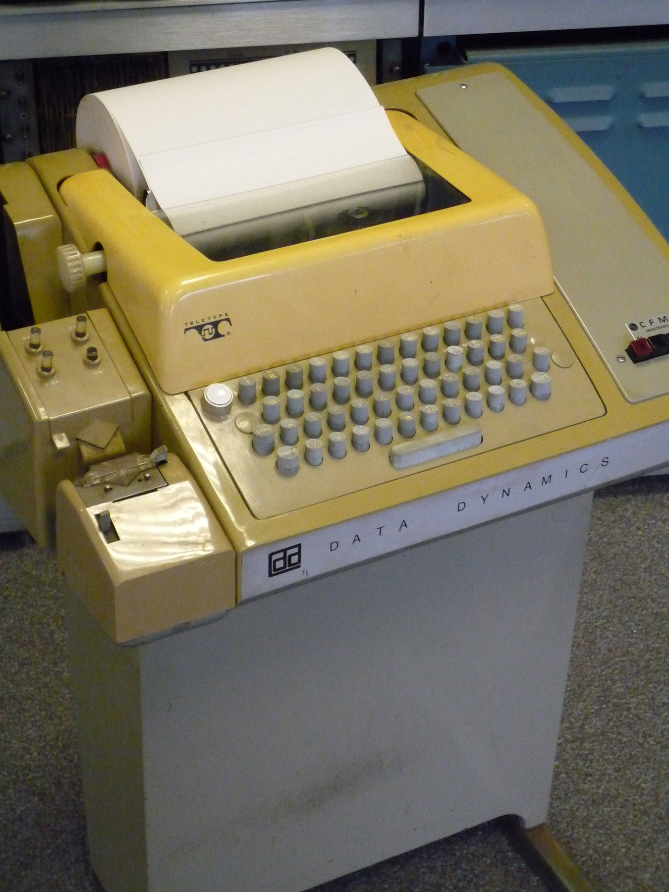
"Teletype with paper tape punch and reader" by AlisonW - Own work. Licensed under Creative Commons Attribution-Share Alike 3.0 via Wikimedia Commons
http://commons.wikimedia.org/wiki/File:Teletype_with_papertape_punch_and_reader.jpg
#mediaviewer/File:Teletype_with_papertape_punch_and_reader.jpg
Notes:
Character sets contain traces of truly ancient computing and communication history.
The first time I sent a program to a computer (summer after junior year in high school) I used a Teletype machine like this.

Slide 35
ASCII character representation
1963, American Standard Code for Information Interchange (ASCII), a 7-bit code, so 128 characters
Compared to Baudot/Murray (1870/1901)
Adds characters for digits 0 through 9, both letter cases, and many new control characters,
and the world has changed dramatically since 1901, so
Character encoding is re-designed for machine-oriented criteria, rather than human-oriented criteria
Make sorting text by machine easier: alphabetic order = integer order of character codes
Simplify machine-performed case-insensitive character matching and the logic circuit for keyboards/printers: upper case and lower case codes for a given letter differ only in leftmost bit position (MSB)

Slide 36
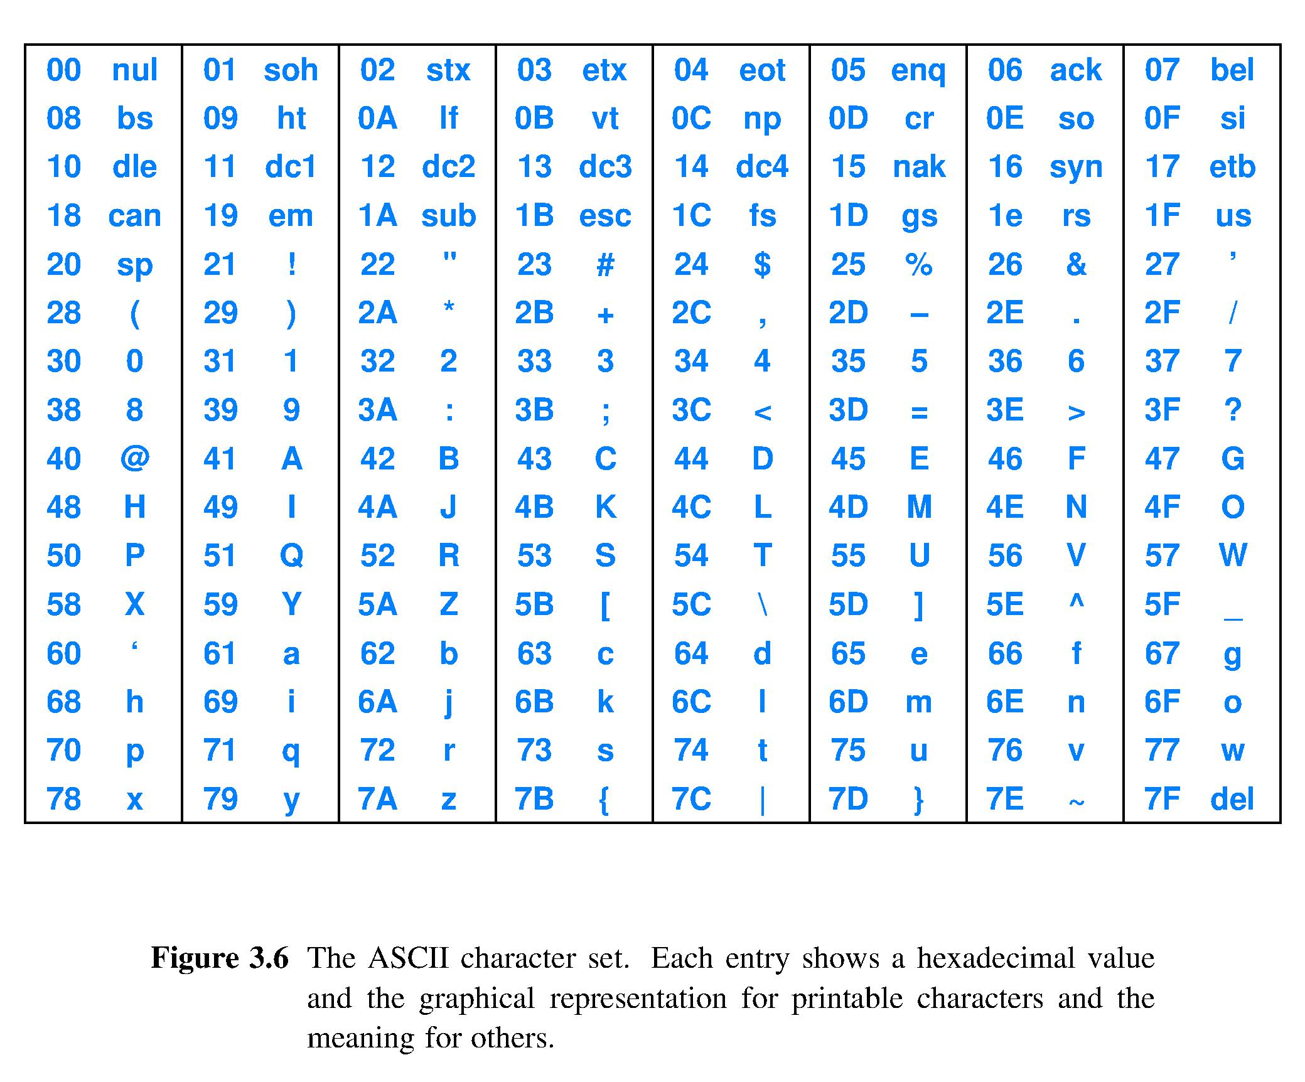
Upper and lower cases intentionally differ by 0x20
07 and 0A are examples of control characters

Slide 37
Other character representations
EBCDIC – Extended, Binary Coded Decimal, Interchange Code
8-bit code for IBM System/360 computers, 1963
Sorts letters before numbers and lowercase before uppercase; opposite of ASCII
Unicode – world standard, version 10.0 current as of June 2017
Up to 4 bytes per character, thus capable of 2³² = 4,294,967,296 characters
Today, 136,755 characters from 139 modern and historic scripts, and multiple symbol sets including emoji
😀 !

Slide 38
Examples to put it all together

Slide 39
Lecture 11 – Representation (part 3)
2018.02.02
“The main problem in computer arithmetic is mapping from the human infinite number system to the finite representational capability of the machine.” Shlomo Wasser and Michael J. Flynn
Introduction to Arithmetic for Digital System Designers
1982

Slide 40
IEEE Floating Point Standard
IEEE 754 standard for floating point (FP) specifies
FP format specified at the bit-string level: transfer of FP data between computers requires no format conversion
Results produced as if using infinitely precise arithmetic then rounded according to specific rules
Exceptional conditions (overflow, divide by zero, etc.) can propagate through a computation in a benign manner, then be handled by software in a controlled fashion
FP software and data run unmodified on diverse computers
Better environment for numerical computation
Encourages standard elementary functions
Provides better support for diagnosis of runtime anomalies
Issues: Addition of FP numbers is not associative, etc.
See CS courses in numerical analysis / scientific computation for details

Slide 41
Reasons for IEEE Floating Point Standard
FP data could not be directly exchanged between different computers because formats were incompatible
FP software could not be easily ported from one computer to another
Unsigned integers and 2’s complement have only one implementation given a fixed number of bits
But # of bits does not define a FP representation, so a standard is needed; IEEE developed it in 1985.
William Kahan (UCBerkeley) received ACM Turing Award for his work on IEEE FP Standard in 1989

Slide 42
Floating point numbers
Floating point (FP) mimics scientific notation ± a x r^{b} where a =significant digits, b order of magnitude, r is radix or base
Example: Avogadro’s number 6.023 x 10²³
+6.023 is the significand or mantissa; shown here with 4 significant digits (non-padding zero digits)
23 is the exponent
10 is the radix, or base
Normalized form: b is chosen so that 1 ≤ |a| < r
Binary is degenerate case for normalization, 1 ≤ |a| < 2, so most significant digit must be 1

Slide 43
Precision and Range
Precision is the resolution of a representation system
Defined as the minimum difference between any two representations
For 32-bit integers, precision is ±1 (± 2⁰)
For IEEE FP precision is equal to ± the weighted positional value of the mantissa LSB
Range is a pair of numbers (smallest, largest) that bounds all representable numbers in a given system
For 32-bit unsigned integers range is (0, 2³²-1)

Slide 44
MSB
30
LSB
Next-to-MSB
22
LSB
↑
sign
(8 bits)
(23 bits or about 7 decimal digits)
(11 bits)
(52 bits or about 16 decimal digits or 1 part in 10¹⁶)
←|→
|
less range←|→less precision
Precision is determined by the number of digits in the mantissa; Range by number of digits in the exponent. Assume a fixed word length. Then moving the dividing line between the exponent and mantissa fields left decreases range and increases precision. If moved right, then the opposite is true. This is the range/precision tradeoff for FP.
Notes:
A lot like playing around with the size of the fields in instructions to gain or loose expressivity w.r.t. # registers, range of offset, etc.

Slide 45
MSB
30
LSB
Next-to-MSB
22
LSB
↑
sign
(8 bits)
(23 bits or about 7 decimal digits)
(11 bits)
(52 bits or about 16 decimal digits or 1 part in 10¹⁶)
STORAGE REPRESENTATION of Floating Point is depicted above.
Sign is a 1-bit field identical in definition to sign-magnitude format.
Exponent is an integer, but has a new representation scheme.
Mantissa is stored without its MSB (most significant bit)
ALU hardware takes advantage of this deeply thought out scheme.

Slide 46
Range of values in IEEE floating point
Single-precision (32-bit format) range is 2⁻¹²⁶ to 2¹²⁷
Double precision (64-bit format) range is 2⁻¹⁰²² to 2¹⁰²³
Approximately equivalent decimal ranges 10⁻³⁸ to 10³⁸ and 10⁻³⁰⁸ to 10³⁰⁸
Exponents for equal values expressed in radix 2 versus 10 are in the ratio of ln 10 / ln 2 ≅ 3.3
In other words, 3.3 bits equal the range of 1 decimal digit

Slide 47
IEEE FP implementation details
Format: Sign | Biased exponent | Mantissa with hidden 1 MSB or s|E|M
Sign field definition same as ever: 0 means + 1 means –
Notes:
Yada, yada, yada

Slide 48
IEEE FP implementation details
Exponent representation: Biased unsigned integer
Bias makes comparing two FP numbers much easier
Range of 8-bit exponent e is –127 to +127 in sign magnitude
Represent e as unsigned integer E = e+Bias where Bias = 127
Thus, 0 ≤ E ≤ 255
Consider FP numbers x₁ = s₁E₁M₁ and x₂ = s₂E₂M₂
Let ⦁ denote concatenation of bit fields and interpret the bit strings s₁⦁E₁⦁M₁ and s₂⦁E₂⦁M₂ as sign magnitude numbers
FP numbers x₁ > x₂ if and only if s₁⦁E₁⦁M₁ > s₂⦁E₂⦁M₂
Biased exponents permits comparing FP numbers using integer compare hardware

Slide 49
IEEE FP implementation details
Normalized mantissa has one significant digit to the left of the radix point
In binary, this digit must be 1, no other choice
Mantissa form is always 1.m₂₂m₂₁…m₁m₀ so
Neither FP registers nor memory store the 1
ALU inserts this 1 bit into each incoming operand, implements this MSB within ALU circuits, then strips it from each result on the way to storage
Compute with one more bit of precision with no memory cost
Called the hidden bit

Slide 50
IEEE FP support for diagnosis of runtime anomalies
Smallest & largest biased exponent values reserved for special uses (and Mantissa MSB=0 in these uses)
±0 written as Sign= 0 or 1, E=0, & Mantissa m bits are all 0s
de-normalized number, used for gradual underflow, written E=0 and Mantissa m bits ≠0, except Mantissa MSB=0
±∞ (± overflows are set to ±∞) written as Sign= 0 or 1, E=255, and m bits =0
Not a Number (NaN) written E=255 & m bits ≠0
Example computations that have a result of NaN: 0/0 , x+∞ , √-x , > or < applied to unordered operands

Slide 51
IEEE FP support for low noise computation
Rounding modes are crucial to retain precision
Inaccurate rounding may inject noise into a computation: result = true value + error
Rounding modes in IEEE 754 FP
Round to nearest: As if computation was done with infinite precision (only slightly hard to do; this is the default mode)
Round towards +∞, round towards –∞
Round towards 0 (simply drop some number of least significant digits, a.k.a. truncation)

Slide 52
Example interpretation of FP
Interpret the following bit string in IEEE FP, then write its value in decimal scientific notation
1100 0001 1111 0000 0000 0000 0000 0000
1 10000011 11100000000000000000000 (sEM)
Recalling hidden 1, three IEEE FP fields literally say – 131 1.11100000000000000000000 which is -1.111 x 2^{131–127} = -1.111 x 2⁴

Slide 53
Conversion between bases
Normalized, weighted positional form is d₀r⁰ + d₋₁r⁻¹ +…+ d_{-j}r^{-j} x r^{B} = d₀.d₋₁…d_{-j} x r^{B}
Denormalize to obtain exponent=0
2⁰ = Y⁰ for any Y a positive integer, so
shift mantissa binary point to be compatible with 2⁰
now can replace base 2 with base Y as Y⁰
then convert mantissa from base 2 to base Y and re-normallize
Example: -1.111 x 2⁴ = -11110.0 x 2⁰ = -30.0 x 10⁰ = -3.0 x 10¹

Slide 54
Example decimal scientific to FP
What bit string represents -9.175 x 10¹ in IEEE FP?
Step 1: determine sign bit Sign = –
Step 2: express -9.175 x 10¹ using x10⁰: 91.75 x10⁰
Step 3: convert integer & fraction of 91.75 to binary 1011011.11 x10⁰ or, equally, x2⁰
Step 4: normalize binary rational number and use 2ª 1.01101111 x 2⁶
Step 5: compute E=e+Bias=6+127=133= 10000101
Step 6: strip mantissa of MSB 1. and assemble fields 1 10000101 01101111000000000000000 regrouped 1100 0010 1011 0111 1000 0000 0000 0000 in hex 0x C 2 B 7 8 0 0 0 or OxC2B78000

Slide 55
Steps in IEEE floating point ADD and SUB
Align mantissas of operands (shift left or right)
Add or subtract mantissas as usual
Normalize mantissa of result (shift again)
Round mantissa of result
Check for overflow or underflow and other runtime anomalies (override bits in result as required) Quite different from and more complex than integer addition and subtraction

Slide 56
Summary
There are many representational forms
All programmers can expect to work with character, integer, and floating point data representations
Some programming tasks benefit from specialized representational forms (BCD, etc.)

